Slide 1



Record Keeping
FOR A SMALL BUSINESS
Updated: 09-2016

Slide 2

Welcome
Agenda
Ground Rules
Introductions

Slide 3
Objectives
Explain the concept of record keeping and its importance to small businesses
Identify record keeping practices, rules, and tools commonly available to small businesses
Explain how record keeping practices, rules and tools work

Slide 4
Objectives
Identify benefits a small business derives from proper record keeping
Explain record keeping basics for a small business
Identify software products available for small business record keeping

Slide 5
What Do You Know?
What do you know or want to learn about record keeping?

Slide 6


Introduction
Record keeping important for small businesses
Sole proprietor
Partnership
Corporation

Slide 7
What is Record Keeping?
Orderly and disciplined practice of storing business records
Ranges from simple (manila folder) to complex (online electronic filing)
Provides fast retrieval of records
Updated on a on-going basis
Remember – Keep good records, both business and personal

Slide 8
Why is Record Keeping Important?
Business Operations
  Tracking details
  Planning
Legal
  Contracts
  Licenses and permits
  Payroll and personnel
Federal, State, and Local Taxes

Slide 9



Business Operations, Tracking Details
Customer records
Sales records
Correspondence
Inventory

Slide 10

Discussion Point #1: Your Record Keeping
Discuss your business record keeping practices.
Identify detail records you already keep.
Identify planning records you already keep.
Identify legal records you already keep.
Identify tax records you already keep.
Think more about your record-keeping.
  Are there records you don’t need to keep? Why not?
  Did we miss any records that you currently keep?
  Are there records that need to be added to the list?
  What area of record-keeping needs your attention?

Slide 11

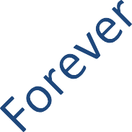
Record Retention
Examples (Years)
Column1
Timecards |  | 2
Personnel files |  |  | 3
Contracts |  |  |  | 4
Inventory |  |  |  | 4
Personnel insurance records |  |  |  |  | 5
Checks and payables |  |  |  |  | 5
Invoices and receivables |  |  |  |  | 5
Payroll |  |  |  |  |  | 6
Retirement plans
Annual statements
Auditors reports

Slide 12

Record Keeping Tools
Simple “paper tools”
“Tickler” system
Computer systems
Cloud computing
  Accounting
  File hosting

Slide 13

Simple “Paper Tools”
File folder
Hanging folder
Cabinet storage
Accordion folder

Slide 14


“Tickler” System
Use a tickler system to remind you of upcoming events such as:
  Quarterly taxes
  License renewals
  Insurance reviews and renewals
  Upcoming bills
  Call-backs

Slide 15
Computer Systems
In addition to paper tools
Takes less space than paper
Faster and easier – Internet transmission
Many businesses and government agencies allow use of Internet
Learn and grow into computer systems over time
Be sure to BACK UP files daily

Slide 16





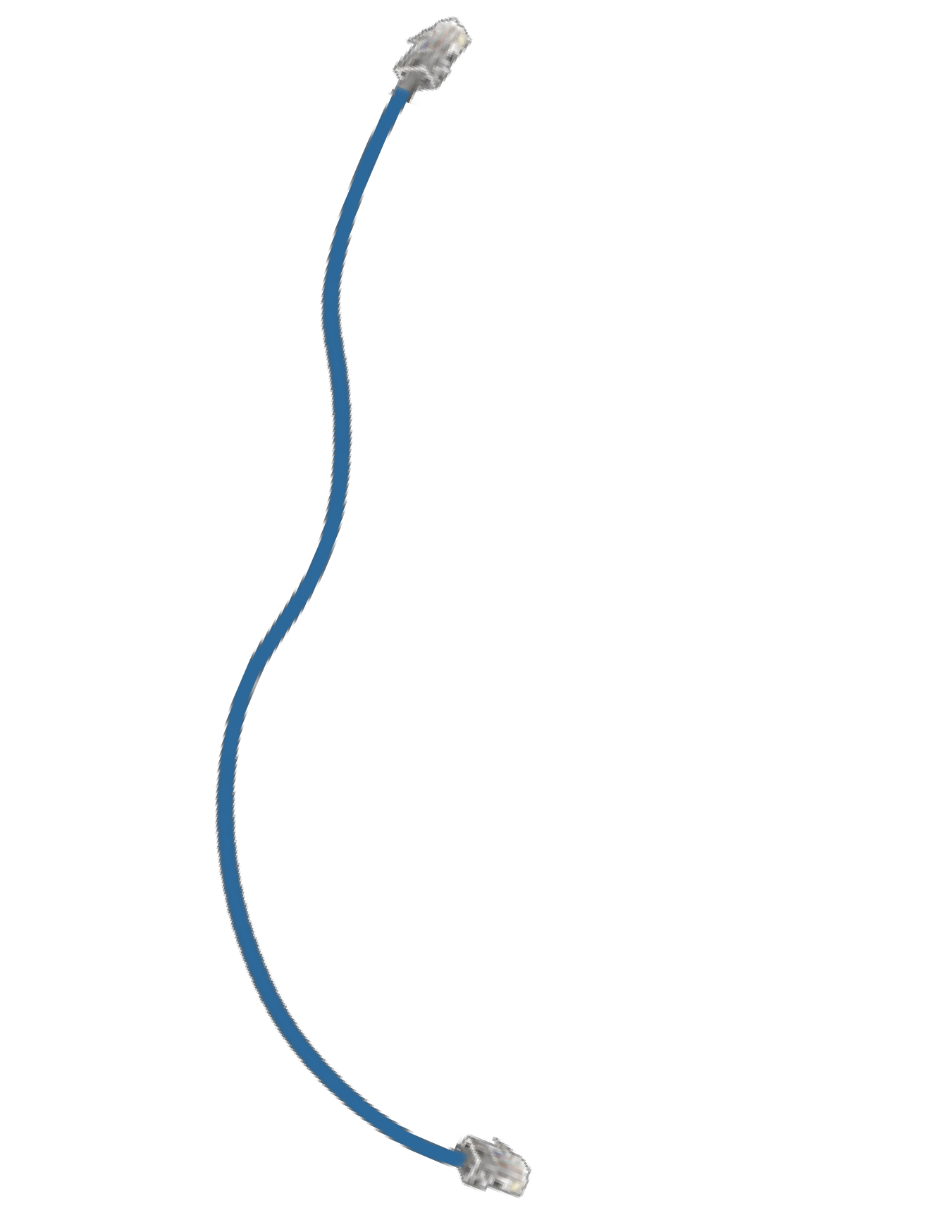

Cloud Computing
Use the Internet to store, manage, and process data (vs. your own personal computer).

Slide 17

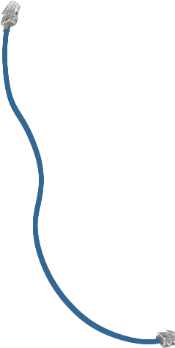
Cloud Computing, Accounting
Offered by accounting software companies
No need to buy software upgrades
No loss of data when computer crashes
Access data from anywhere

Slide 18


Cloud Computing, File Hosting
Share with colleagues or clients
Share large files
No loss of files when computer crashes
Accessible from anywhere
Free and fee-based options

Slide 19









Business Software
Evaluate business needs
Many software products available
  Spreadsheets
  Email
Accounting
AND OR

Slide 20

Business Software, Evaluate Business Needs
Inventory tracking?
Manufacturing
E-commerce?
Multiple users?
Industry specialization?
Online options?
Anything else?

Slide 21

Business Software, Email
Communicate with clients, employees, suppliers, vendors, contractors, etc.
Use “local” computer or webmail
Keep good records by creating email filing system

Slide 22

Business Software, Spreadsheets
Track information such as clients, inventory, sales, employee time sheets, etc.
Matrix of rows and columns
Frequently used for financial “what-if” scenarios

Slide 23




Business Software, Accounting
Track business financial records such as sales, expenses, inventory, and assets
Many advantages
Reduced errors
Faster
Inexpensive
Better organization
Better organization
Reduced errors
ACCOUNTING SOFTWARE
Inexpensive
Faster calculations

Slide 24
Discussion Point #2: Accounting System
Take some time to think about your accounting system.
Describe it.
How might it be improved?
What specific improvements are you thinking about?

Slide 25

Business Software Training
Tutorials and free trials
Online software training and webinars
YouTube
SBA Resource Partners – SCORE,
Small Business Development Centers, Women’s Business Centers, US Export Assistance Centers,
Veterans Business Outreach Centers
Community Colleges
Accountants
Bookkeepers and Consultants

Slide 26

Now
Start now with something that works
Refine as business grows

Slide 27
Key Points to Remember
Use record keeping tools that work for your business type, size, and complexity
Evaluate your business needs before purchasing business software
Again – START NOW

Slide 28

Summary
What final questions do you have?
What have you learned?
How would you evaluate the training?

Slide 29
Conclusion
You learned about:
What record keeping is and how it’s important
Record keeping basics – practices, rules, and tools
Which records to keep – tracking, planning, legal, and taxes
Benefits of record keeping
Business software available for record keeping
Business software training

