Slide 1
Selling a Small Business
and Succession Planning FOR A SMALL
BUSINESS

Slide 2
Welcome
Agenda
Ground Rules
Introductions

Slide 3
Objectives
Change ownership of a business through selling, closing, or handing to a successor.
Establish an exit strategy for retirement including a succession plan, transfer of ownership, and taxes.

Slide 4
What Do You Know?
What do you know or want to learn about selling a small business and succession planning?

Slide 5
Why Sell?
Business or Professional reasons include
An advantageous job offer from another company
A promising offer to buy your business or business assets
Sales and profits are not enough to meet your needs
Market or industry changes

Slide 6
Why Sell?
Some personal considerations include
Ready to retire
Burned out working for yourself
Personal issues such as health or family needs
Desire to go in a new direction

Slide 7
Discussion Point #1: Reasons for Selling the Business
What is the main reason for selling your business?

Slide 8
Steps to Selling a Business

Slide 9
Determine If Business is Saleable
Strong profits
In an attractive industry
Potential buyers
Good assets
Quality inventory
Transfer to another person
Healthy balance sheet

Slide 10
Determine Your Price
Valuing the revenue stream
Net profit over time
Valuing the assets
Cash
Receivables
Inventory
Equipment
Real Estate

Slide 11
Prepare For Sale
Resolve Problems
Accounts receivable can be collected
Prepare financial statements
Provide business plan
Secure relationships
Sell old inventory
Office equipment is in good order
How will you be compensated

Slide 12
Look for Prospective Buyers
Employees
Customers
Business owners
Competitors

Slide 13
Negotiating the Deal
Qualifying your buyer
Lump sum versus installments
Non-compete clauses
Management assistance
Down payment
Collateral

Slide 14
Discussion Point #2: Challenges of Selling the Business
What are some of the challenges of selling your business?

Slide 15
Closing a Business
Steps for closing a business
Follow instructions in founding documents
Sell business assets
Cancel permits, licenses, lease agreements
Comply with federal income tax laws
Resolve outstanding issues with customers, creditors, and suppliers
Maintain records
Get professional help

Slide 16
Planning Succession
A plan for someone to either own or run your business after you retire

Slide 17
Discussion Point #3: Benefits of Selecting a Successor
What is the most important reason for selecting a successor?

Slide 18
Issues to Consider in Succession Planning
Start early
Identify successors
Train successors
Plan for tax exposure
Get legal advice

Slide 19
Planning Retirement

Slide 20
Retirement Plan Benefits
Employer contributions are tax-deductible.
Assets in the plan grow tax-free.
Flexible plan options are available.
A retirement plan can attract and retain better employees, reducing new employee training costs.

Slide 21
Employee Benefits
Reduce current taxable income
Not taxed until distributed
Easy to make through payroll deductions
Compounding interest over time
Retirement assets can be carried from one employer to another
Opportunity to improve financial security in retirement

Slide 22
Retirement Plans
Common Retirement Plans
SEP
SIMPLE
401K
Make regular contributions
Get professional advise

Slide 23
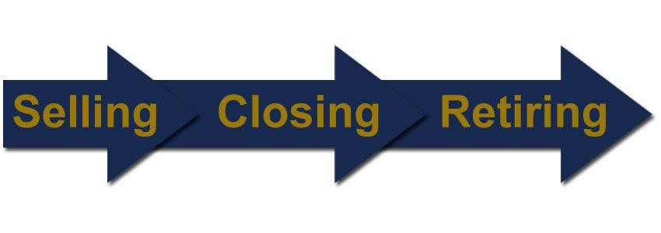
Top Three Key Points to Remember
Plan for the possibility of selling and closing a business
Start making plans as soon as possible.
Create a retirement plan you and your employees

Slide 24
Conclusion
You learned about:
Reasons for selling and closing a business.
Steps for selling or closing a business
Steps for succession planning
Benefits and steps for creating a retirement plan.

Slide 25
Summary
What final questions do you have?
What have you learned?
How would you evaluate the training?

